Slide 1

INVERTIS UNIVERSITY
IIOT MAJOR PROJECT
Team Leader
Team Members
Sanskriti Saxena
9
Other Team Members
Niharika Negi.
Anmol Mishra.
Priyanshi Dubey.
Vaishnavi Varshney.
Ansh Kulshrestha.
Adama Ousman.
Satyam.
Alankar Maurya.
MCA (AI &ML)
2026-27
Project Guide
Mr. Divyank Chauhan Assistant Professor

Slide 2

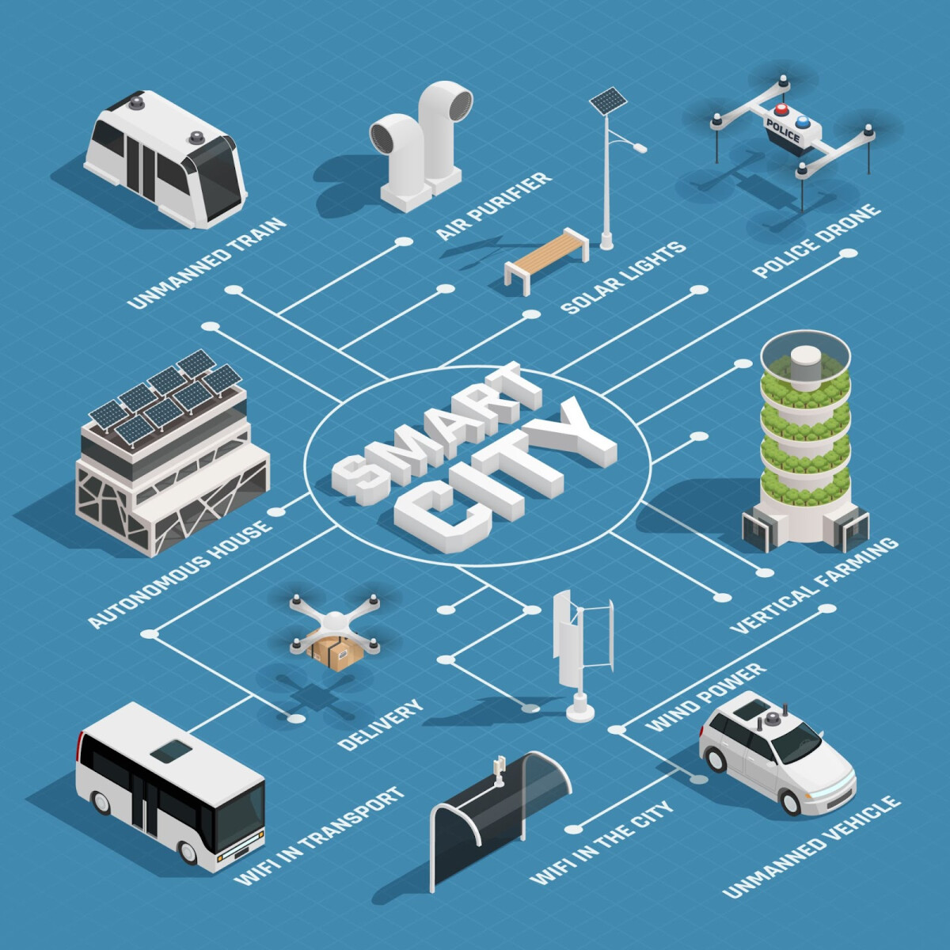
SMART CITY ANALYSIS SYSTEM
CORE STACK:
Python
Jupyter
MySQL
Power BI
Excel

Slide 3


OVERVIEW
Project Introduction
4 Core Domains
Comprehensive analysis across waste, energy, traffic, and crime.
Kaggle Datasets & Cleaning
Structured preprocessing and anomaly removal on authentic data.
SQL & Power BI Integration
Seamless database connectivity backing live interactive dashboards.

Slide 4
STRATEGIC ALIGNMENT
Objectives
Core Objectives
Unify Datasets: Process 4 major Kaggle urban datasets seamlessly.
Execute EDA: Extract statistical patterns using Python & Pandas.
Deploy Pipelines: Build SQL storage and Power BI dashboards.
Outcome: Actionable intelligence for modern smart city governance.

Slide 5




ANALYTICAL SCOPE
Four Major Domains
Waste
Energy
Traffic
Crime
Generation rates, bin fill levels, and pickup route efficiency.
Power consumption trends, peak load demand, and grid loads.
Vehicle density, bottleneck zones, and peak congestion hours.
Incident frequency, spatial distribution, and safety hotspots.
Metric: Collection Efficiency
Metric: Energy Consumption
Metric: Congestion Index
Metric: Incident Density

Slide 6
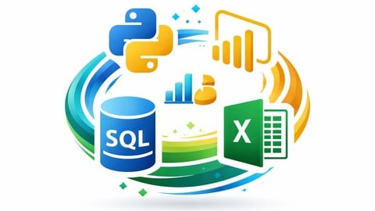



INFRASTRUCTURE
Technology Stack
Python & Jupyter Notebook
Pandas, NumPy, Matplotlib & Seaborn for data wrangling and EDA.
MySQL Relational Database
Structured relational tables with automated Python connector scripts.
Power BI & Microsoft Excel
Interactive dashboards, PivotTables, DAX measures, and slicers.

Slide 7
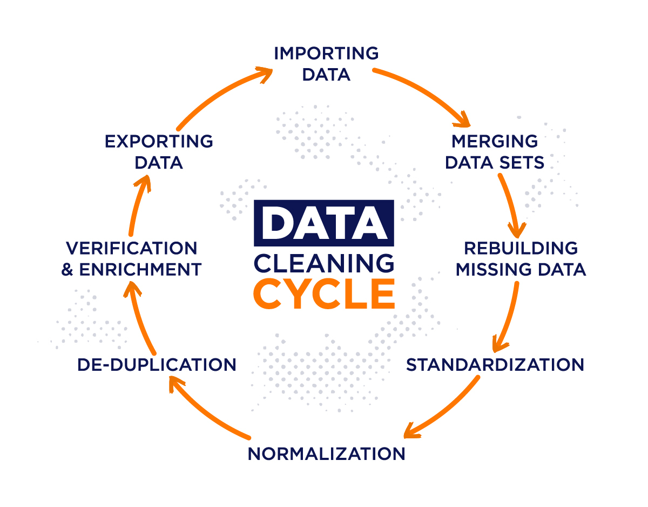
PIPELINE STAGE 1
Data Cleaning & EDA
1
Dataset Inspection & Null Handling
Imputed missing values and purged duplicate records across all 4 tables.
2
Data Type Standardisation
Converted timestamp formats and cast numeric variables for SQL insertion.
3
Statistical Visualization
Generated Seaborn heatmaps and distributions to detect urban outliers.

Slide 8
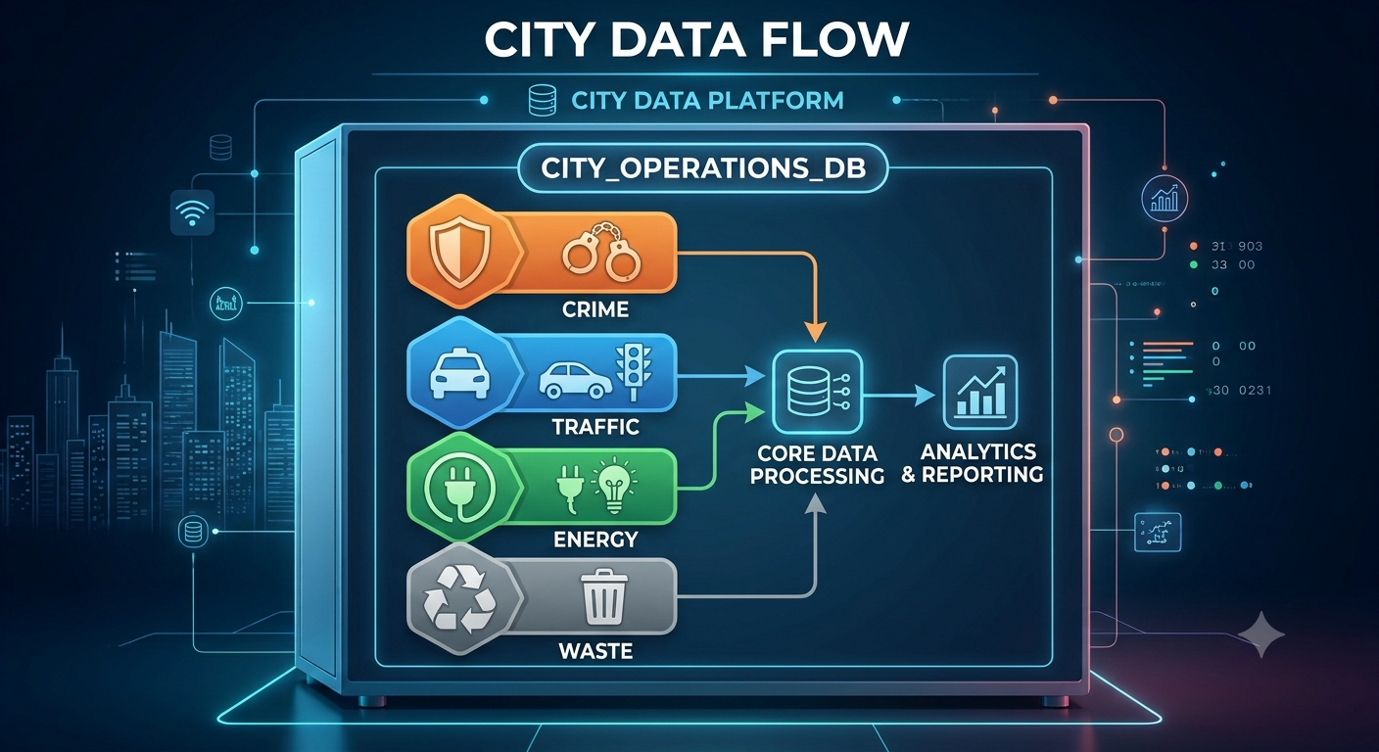
PIPELINE STAGE 2
SQL Database Connectivity
Schema & Table Creation
Designed relational schema optimized for time-series urban queries.
Python–MySQL Bridge
Automated batch data insertion using MySQL Connector Engine.
SQL Retrieval Queries
Executed aggregated queries to feed downstream BI reporting dashboards.

Slide 9

VISUALIZATION CORE
Dashboard Features
Dynamic KPI Cards & Slicers
Real-time metric summaries filtered by date, zone, and severe status.
Multi-Visual Charts
Bar charts, line trends, and donut distributions for rapid visual analysis.
Cross-Filtering Architecture
Selecting one visual dynamically updates all connected urban metrics.

Slide 10
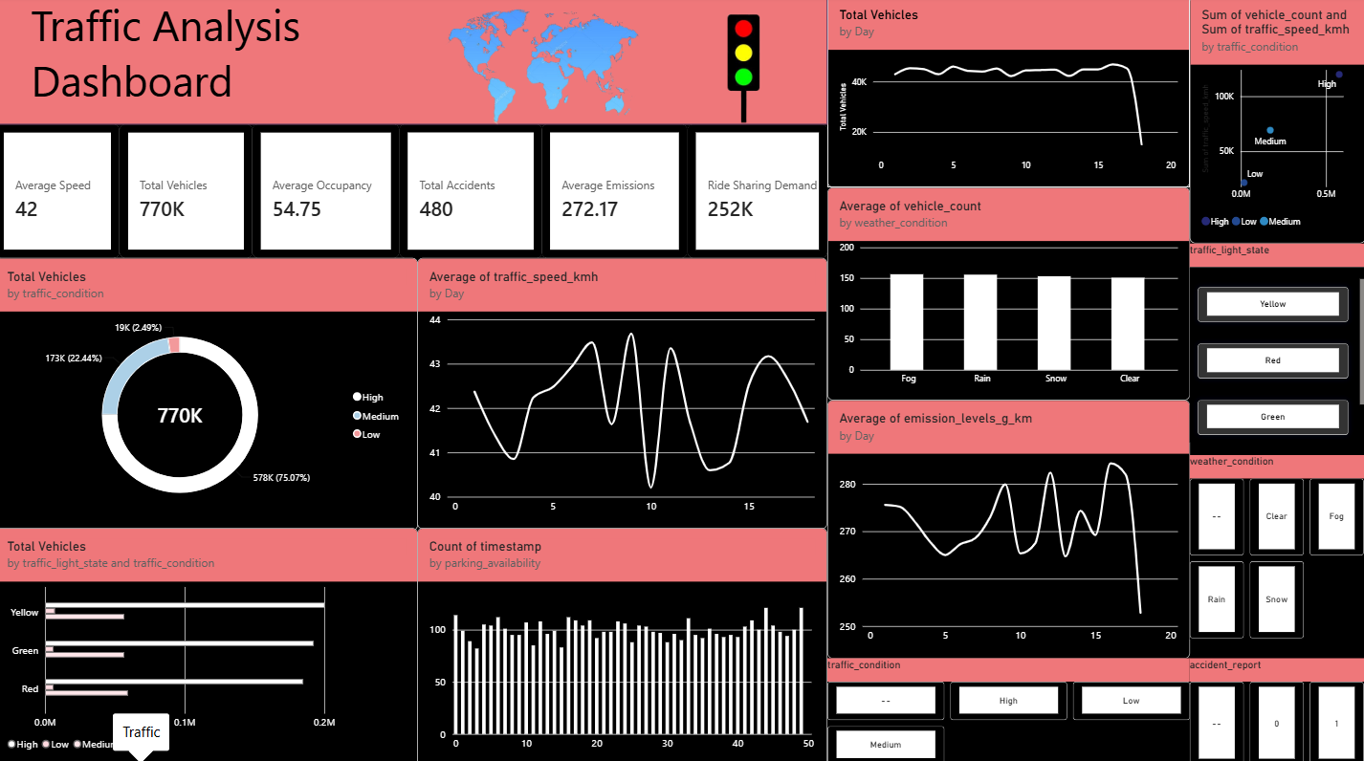
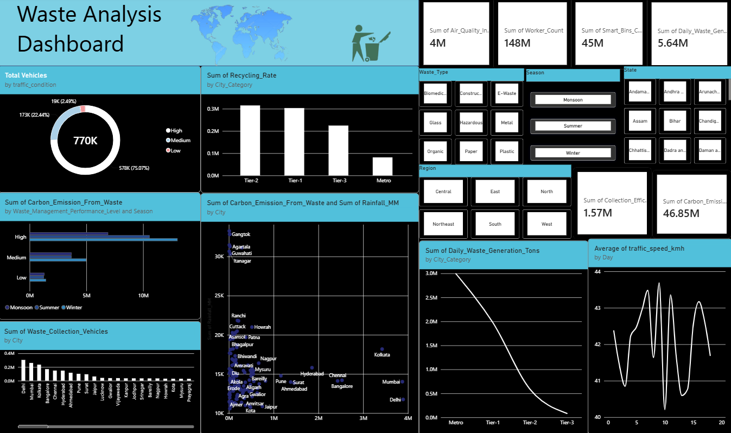
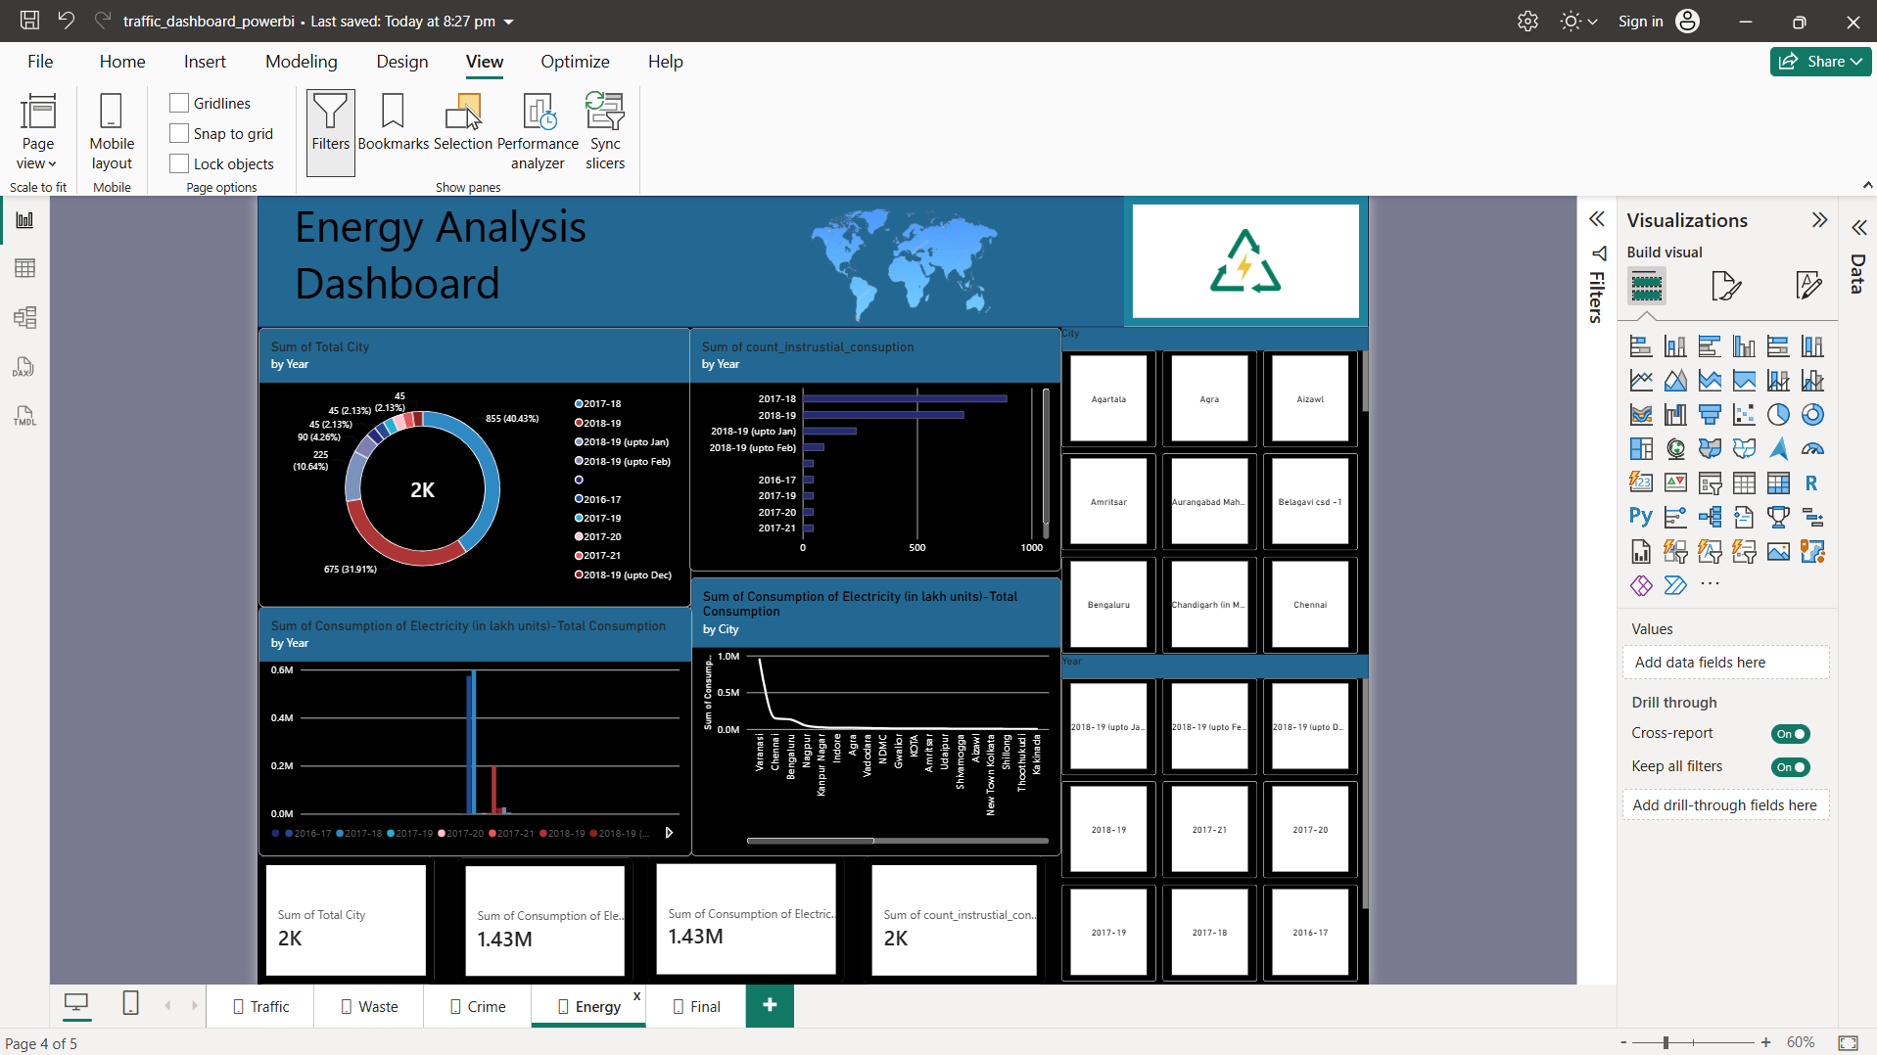
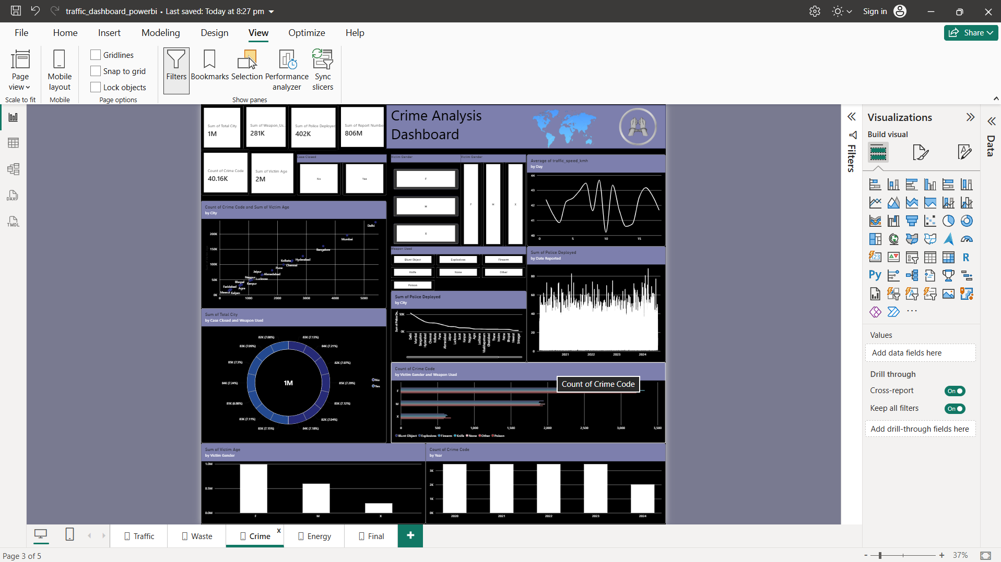
REPORTING ENGINE
Domain-Wise Dashboard Analytics
Traffic Control
Congestion indices & bottleneck zone identification.
Waste Analytics
Collection efficiency & bin capacity hotspots.
Energy Metrics
Peak consumption spikes & grid load status.
Crime Mapping
Spatial safety scores & high-risk patrol zones.

Slide 11
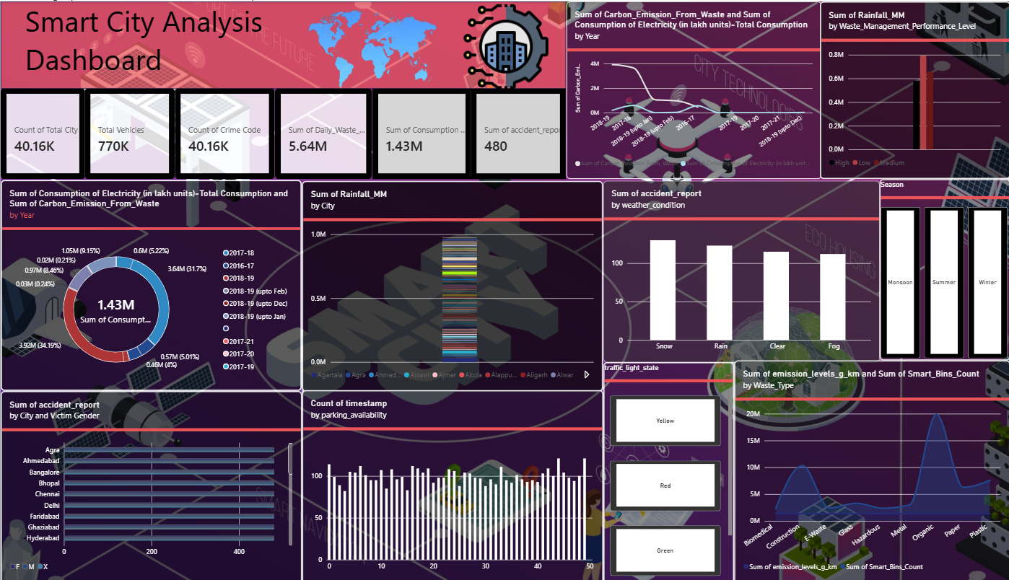
ALTERNATIVE REPORTING
Interactive Final Dashboard
PivotTables & PivotCharts
Rapid data summaries and dynamically linked visual chart components.
Timeline Slicers & Filters
Interactive slice-and-dice controls for executive reporting.
Summary KPI Metrics
Compact operational view for stakeholders without Power BI access.

Slide 12

EXECUTION & LEADERSHIP
Team Contribution
STRUCTURE
Team Leader: Sanskriti Saxena
Managed 9 team members across data processing, SQL, and dashboard units.
Niharika Negi.
Anmol Mishra.
Priyanshi Dubey.
Vaishnavi Varshney.
Ansh Kulshrestha.
Adama Ousman.
Satyam.
Alankar Maurya.
KEY RESPONSIBILITIES
Team coordination and task allocation
Data pipeline monitoring & quality control
Cross-module integration & dashboard delivery

Slide 13
SUMMARY & VISION
Conclusion & Future Scope
Conclusion
Future Scope
Successfully analyzed 4 critical domains.
Real-time IoT sensor integration & live feeds.
Engineered robust Python & SQL data pipeline.
AI-based predictive traffic and energy models.
Deployed Power BI & Excel interactive dashboards.
Automated municipal alert and platform monitoring.

Slide 14

Helping
References
Microsoft Documentation. Get Started with Power Query in Excel. Available at: https://support.microsoft.com/excel
Microsoft Documentation. Using Pivot Tables for Data Analysis. Available at: https://support.microsoft.com/pivottable
Microsoft Learn. Excel Charts and Visualization Tools. Available at: https://learn.microsoft.com/excel
StackOverflow Community Discussions – Excel Formula & Query Solutions. https://stackoverflow.com
Textbook: Data Analytics for Beginners, Pearson Education.
YouTube Tutorials on Excel Dashboard Designing (accessed during project preparation):
  Leila Gharani Excel Dashboard Tutorials
  ExcelIsFun Dashboard Series
THANK YOU

